Slide 1
PySpark: DataFrames/SparkSQL + GraphFrames/GraphX
Submitted by Manish Bafna
Student Id: 19655
Instructor: Dr. Henry Chang

Slide 2
Table of Content
Introduction
Design
Implementation
Test
Conclusion
Enhancement Ideas
References

Slide 3
Introduction
GraphFrames is a package for Apache Spark which provides DataFrame-based Graphs. It provides high-level APIs in Scala, Java, and Python
It aims to provide both the functionality of GraphX and extended functionality taking advantage of Spark DataFrames
GraphFrames are an abstraction of DataFrames that are used to do Graph Analytics.
Graphs are a combination of vertices that are connected to each other using edges
While vertices can be thought of as nodes or entities, edges represent the relationship between these entities.
Some of the applications of Graph Theory include social media problems, travel, chip design, and many other fields. Google introduced the PageRank algorithm that is based on Graph Theory.

Slide 4
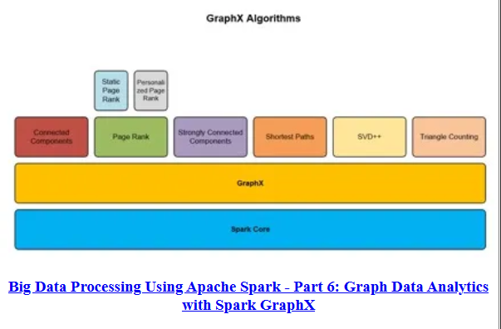
Design
GraphFrame mainly provides the following built-in algorithms:
Triangle count
PageRank
Shortest Path

Slide 5
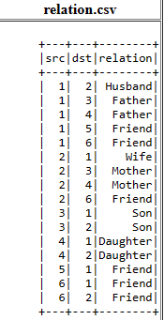
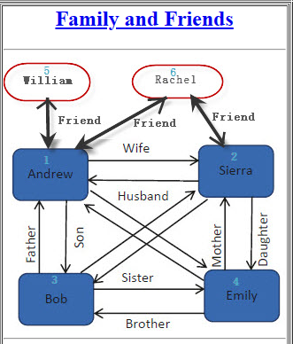
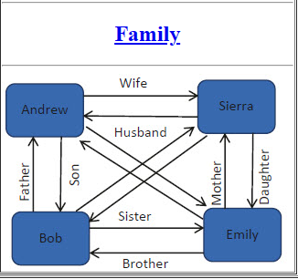
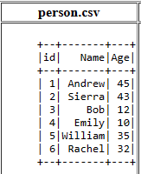
Design
GraphFrames and GraphX are useful tools for working with graph data in Spark. However, GraphFrames is generally easier to use and more efficient, as it is built on top of the DataFrame API, which is more optimized for large-scale data processing.
We use the below data set

Slide 6
Implementation
Create the Virtual Machine on GCP and SSH into it:

Slide 7
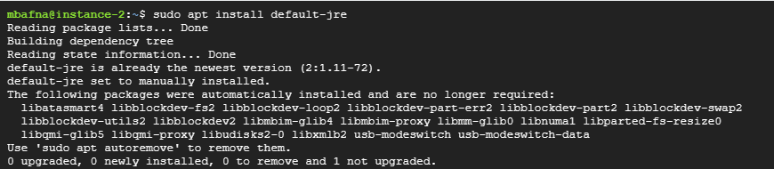
Implementation
Install Java:
sudo apt-get update
sudo apt-get install openjdk-11-jdk

Slide 8
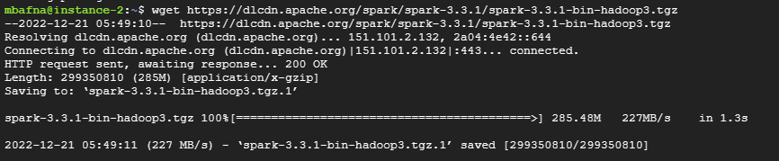
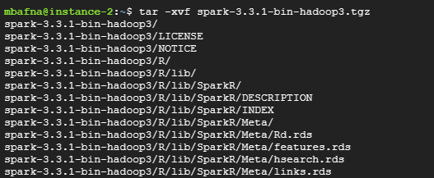
Implementation
Install Spark and Unpack it:
wget https://dlcdn.apache.org/spark/spark-3.3.1/spark-3.3.1-bin-hadoop3.tgz
tar -xvf spark-3.3.1-bin-hadoop3.tgz
mv spark-3.3.1-bin-hadoop3 spark

Slide 9
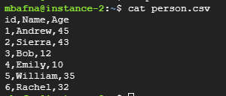
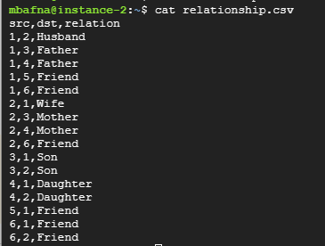
Implementation
Create graphX directory and then prepare person.csv and relationship.csv file into graphX directory
mkdir graphX
vi person.csv
vi relationship.csv

Slide 10
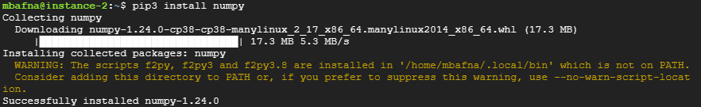
Implementation
Install Numpy Library:
sudo apt install python3-pip
pip3 install numpy

Slide 11
Implementation
Prepare for the Code:
graphX.py Download Link:Cloud-Computing/Apache Spark + GraphFrame + GraphX at main · manishbafna22/Cloud-Computing (github.com)

Slide 12
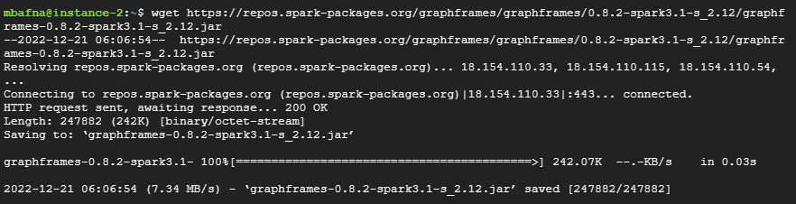
Implementation
Download GraphFrames jar file:
wget https://repos.spark-packages.org/graphframes/graphframes/0.8.2-spark3.1-s_2.12/graphframes-0.8.2-spark3.1-s_2.12.jar

Slide 13
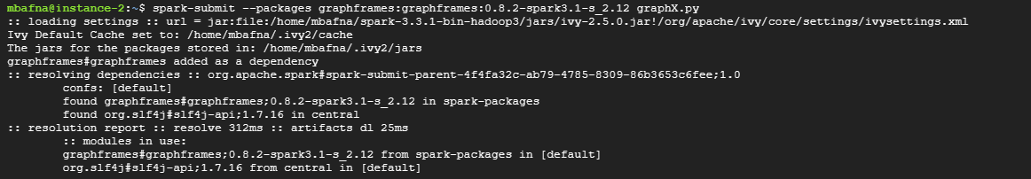
Test
Submit PySpark Job:
spark-submit --packages graphframes:graphframes:0.8.2-spark3.1-s_2.12 graphX.py

Slide 14
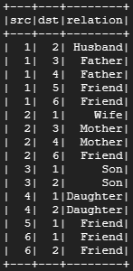
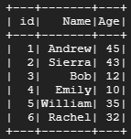
Test
Output:
GraphFrame:

Slide 15



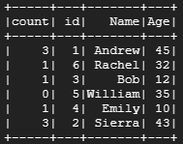

Test
TriangleCount:

Slide 16
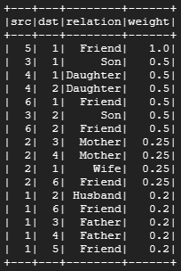
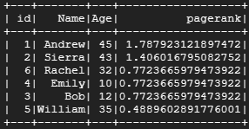
Test
PageRank:

Slide 17

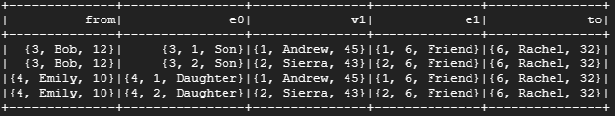

Test
BFS

Slide 18
Enhancement Ideas
Implement GraphX for movie recommendation data
Implement GraphX for Fraud Detection data

Slide 19
Conclusion
GraphX is well-suited for tasks such as social network analysis, recommendation engines, and fraud detection, and is a powerful tool for working with graph data in Apache Spark
And using GraphX, we can analyze a social network to identify influential users or communities, or to build a recommendation engine based on the connections between users and items.

Slide 20
References
Dorpe, S. (2018, July 23). GraphFrames in Jupyter: A practical guide. Retrieved December 18, 2022, from https://towardsdatascience.com/graphframes-in-jupyter-a-practical-guide-9b3b346cebc5#:~:text=The%20functionality%20of%20GraphFrames%20and,browsing%20through%20the%20API%20documentation.
San Francisco Bay University. SFBU. (n.d.). Retrieved December 18, 2022, from https://www.sfbu.edu/

